Slide 1
Enhanced MIMO-SAR Scanner
Using a Custom Built Synchronization Module
Muhammet Emin Yanik PhD, Radar Systems Engineer
June 2023

Slide 2
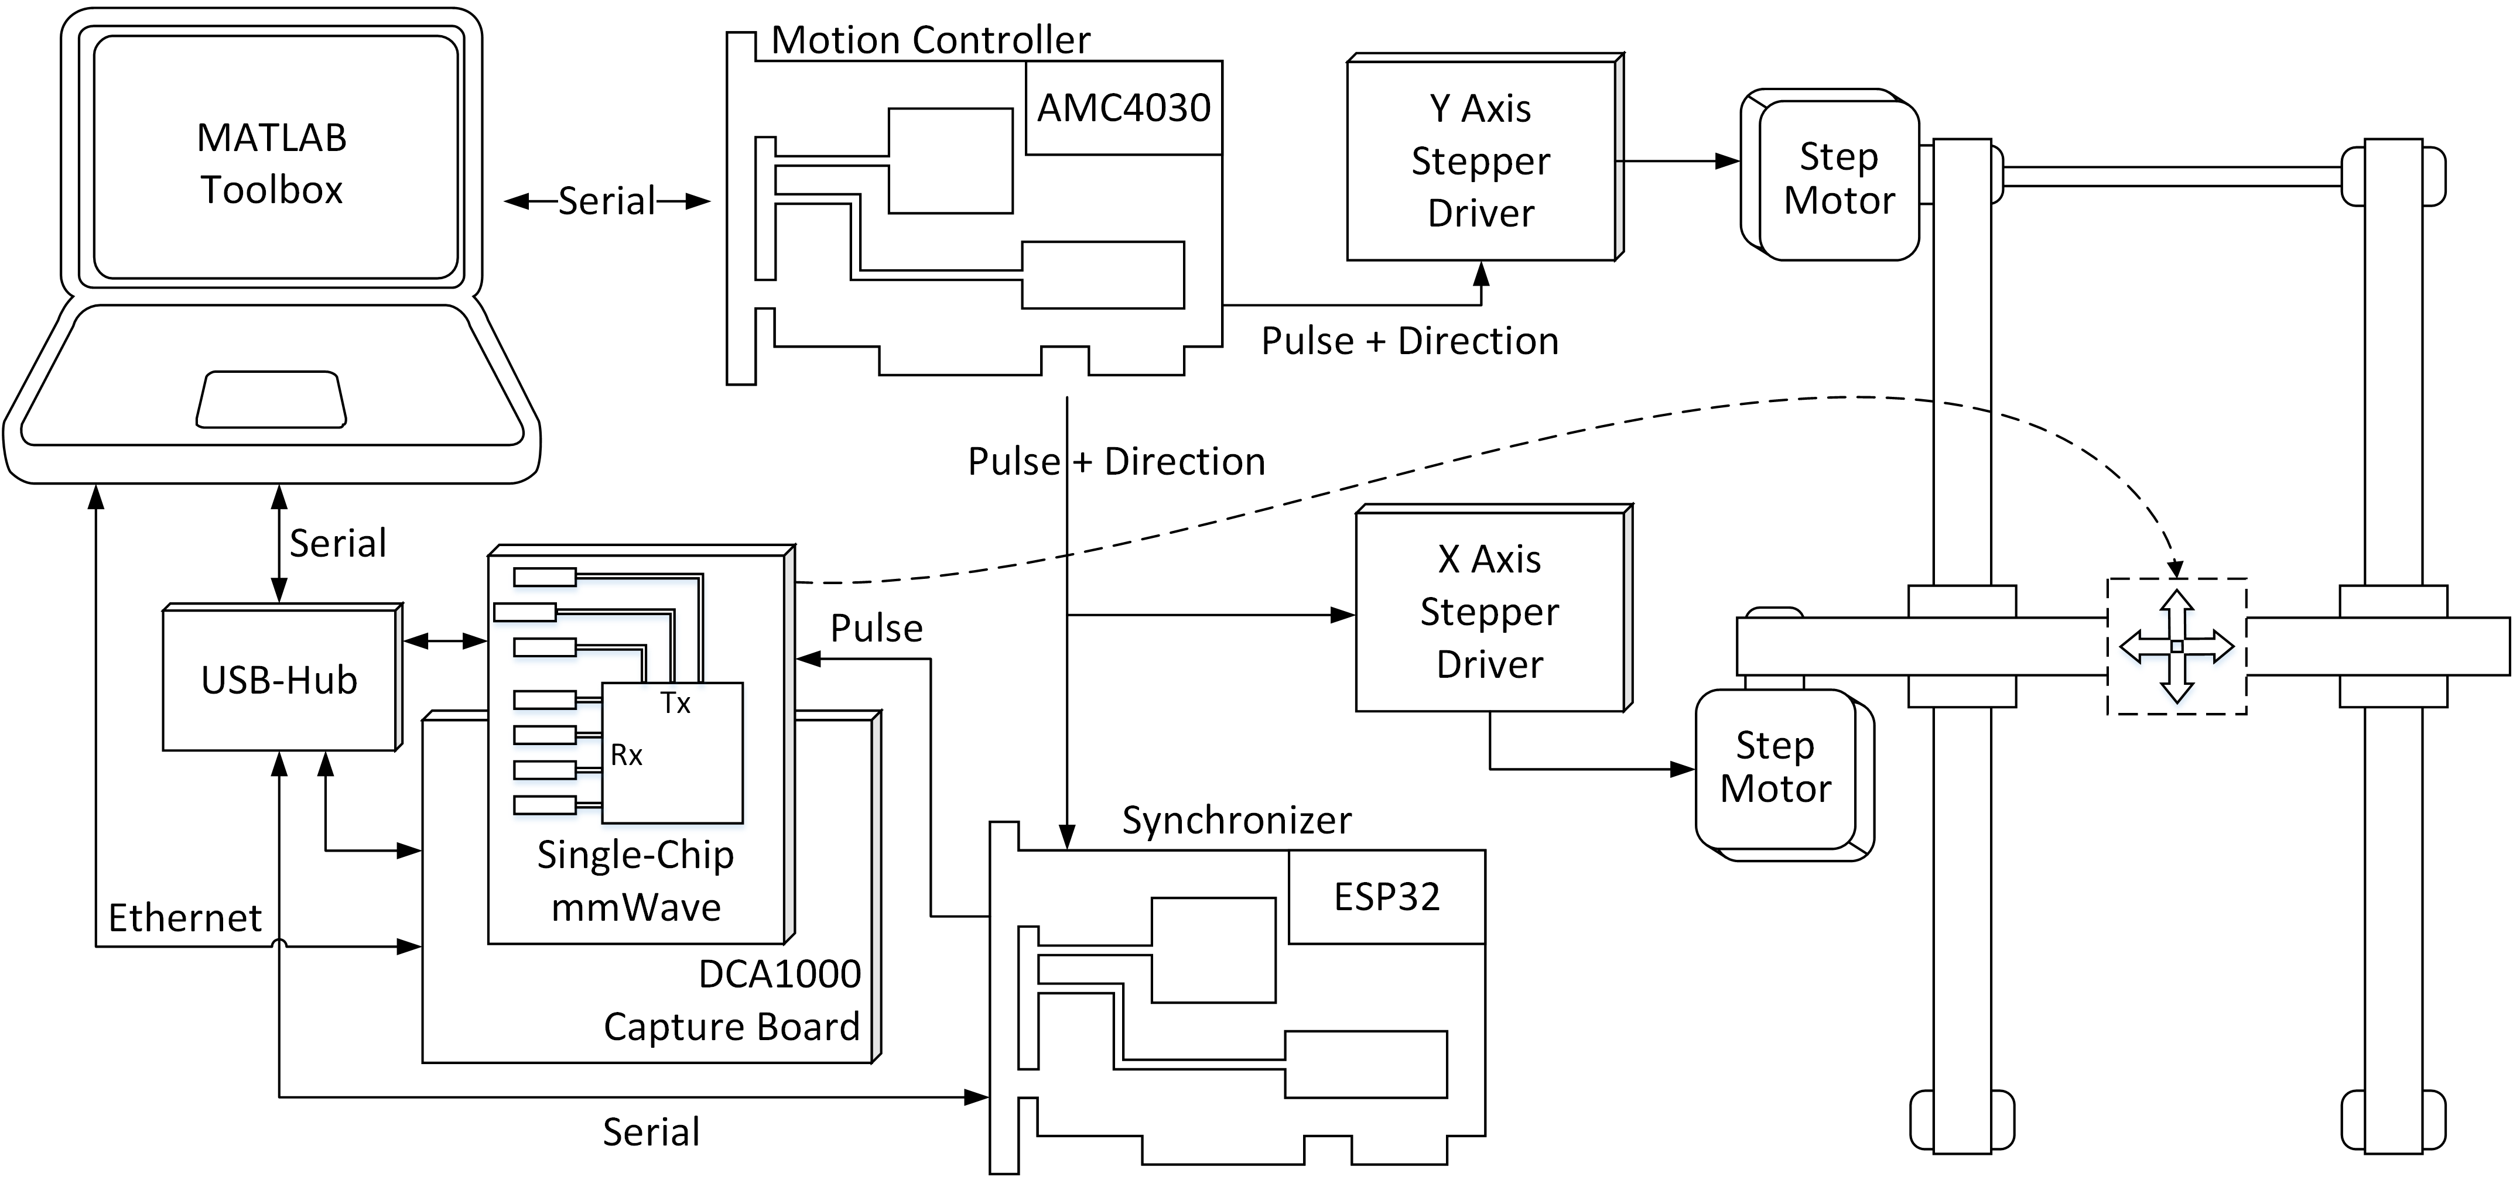
Enhanced System Architecture with Synchronizer
The MIMO-SAR framework is improved using a synchronizer module.
A new synchronizer module is developed
HW: ESP32-based, SW: written in C++ on freeRTOS
2

Slide 3
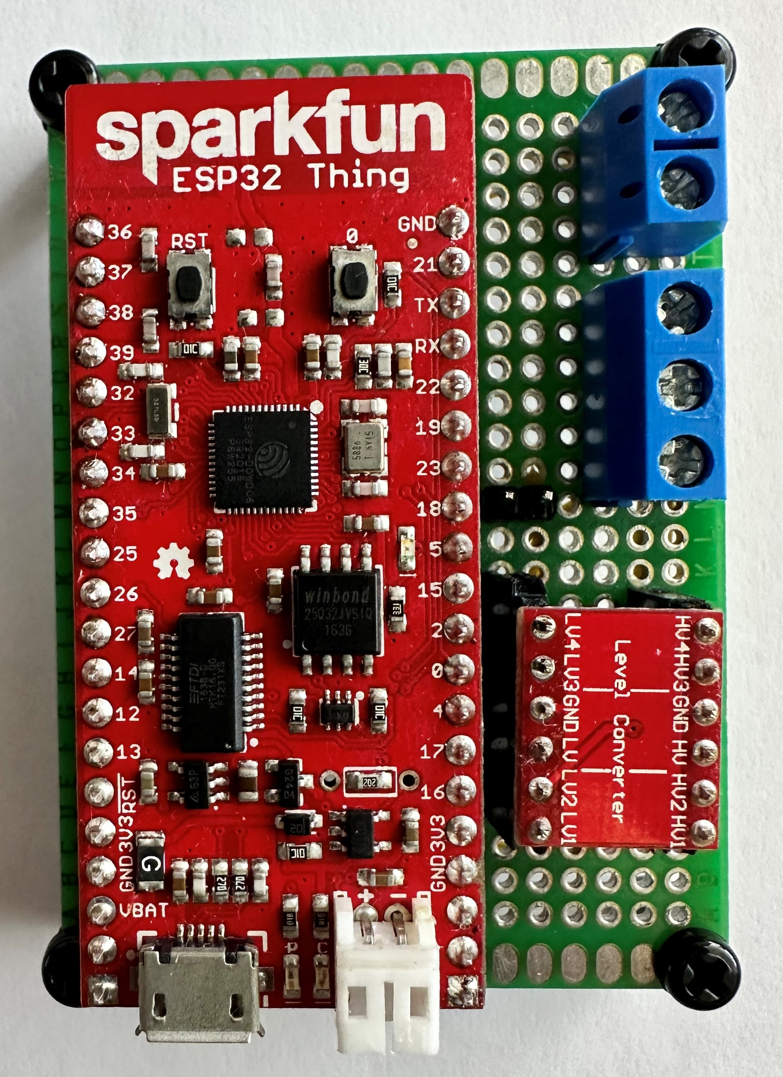
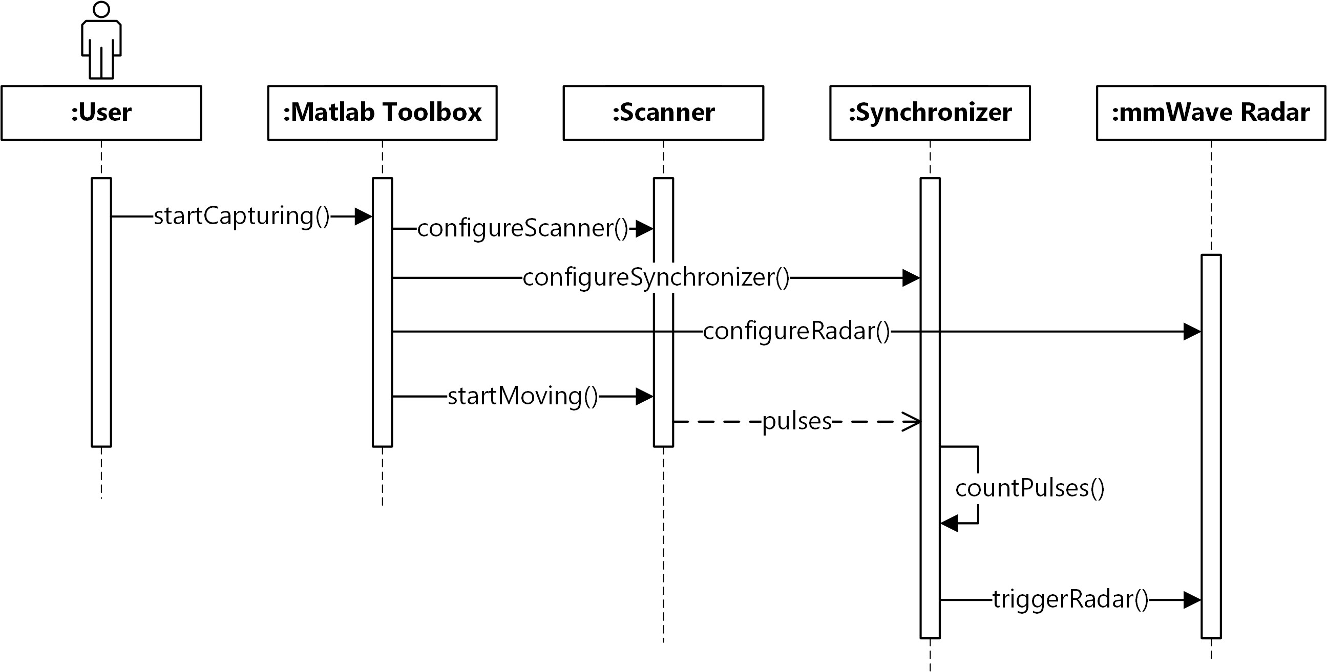
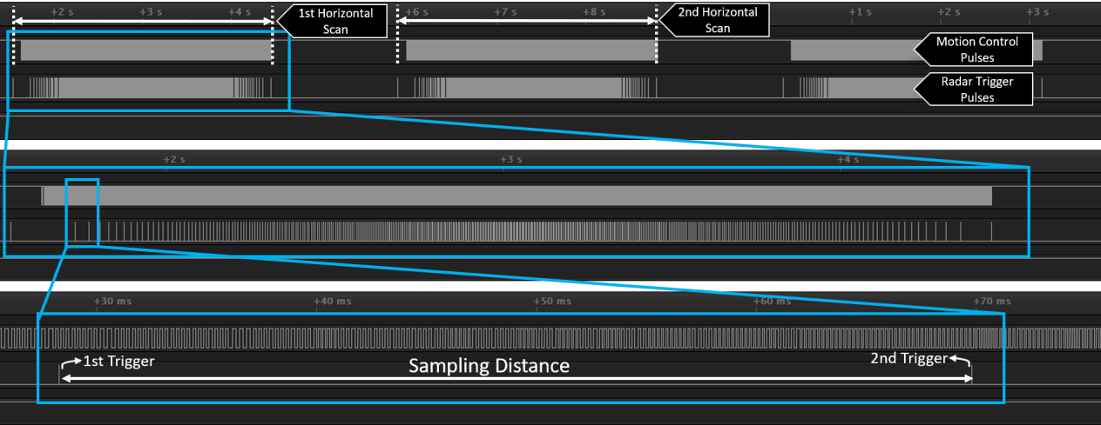
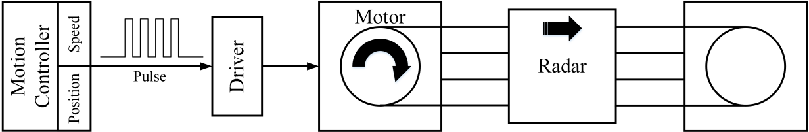
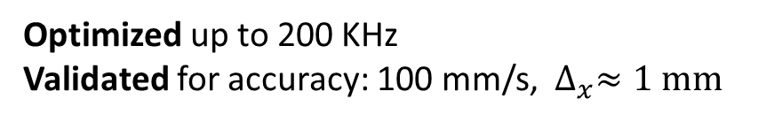
Radar Synchronization – Approach
A custom built real-time synchronization module is added as a universal solution
No speed or acceleration assumption, generic, can work for all type of scanners using stepper motors
Synchronizer:
Pulse counter from motion controller
Hardware trigger of radar
Optimized up to 200 KHz
Validated for accuracy: 100 mm/s, $∆_{x}≈1 mm$
All the stepper motors use the same architecture
3

Slide 4
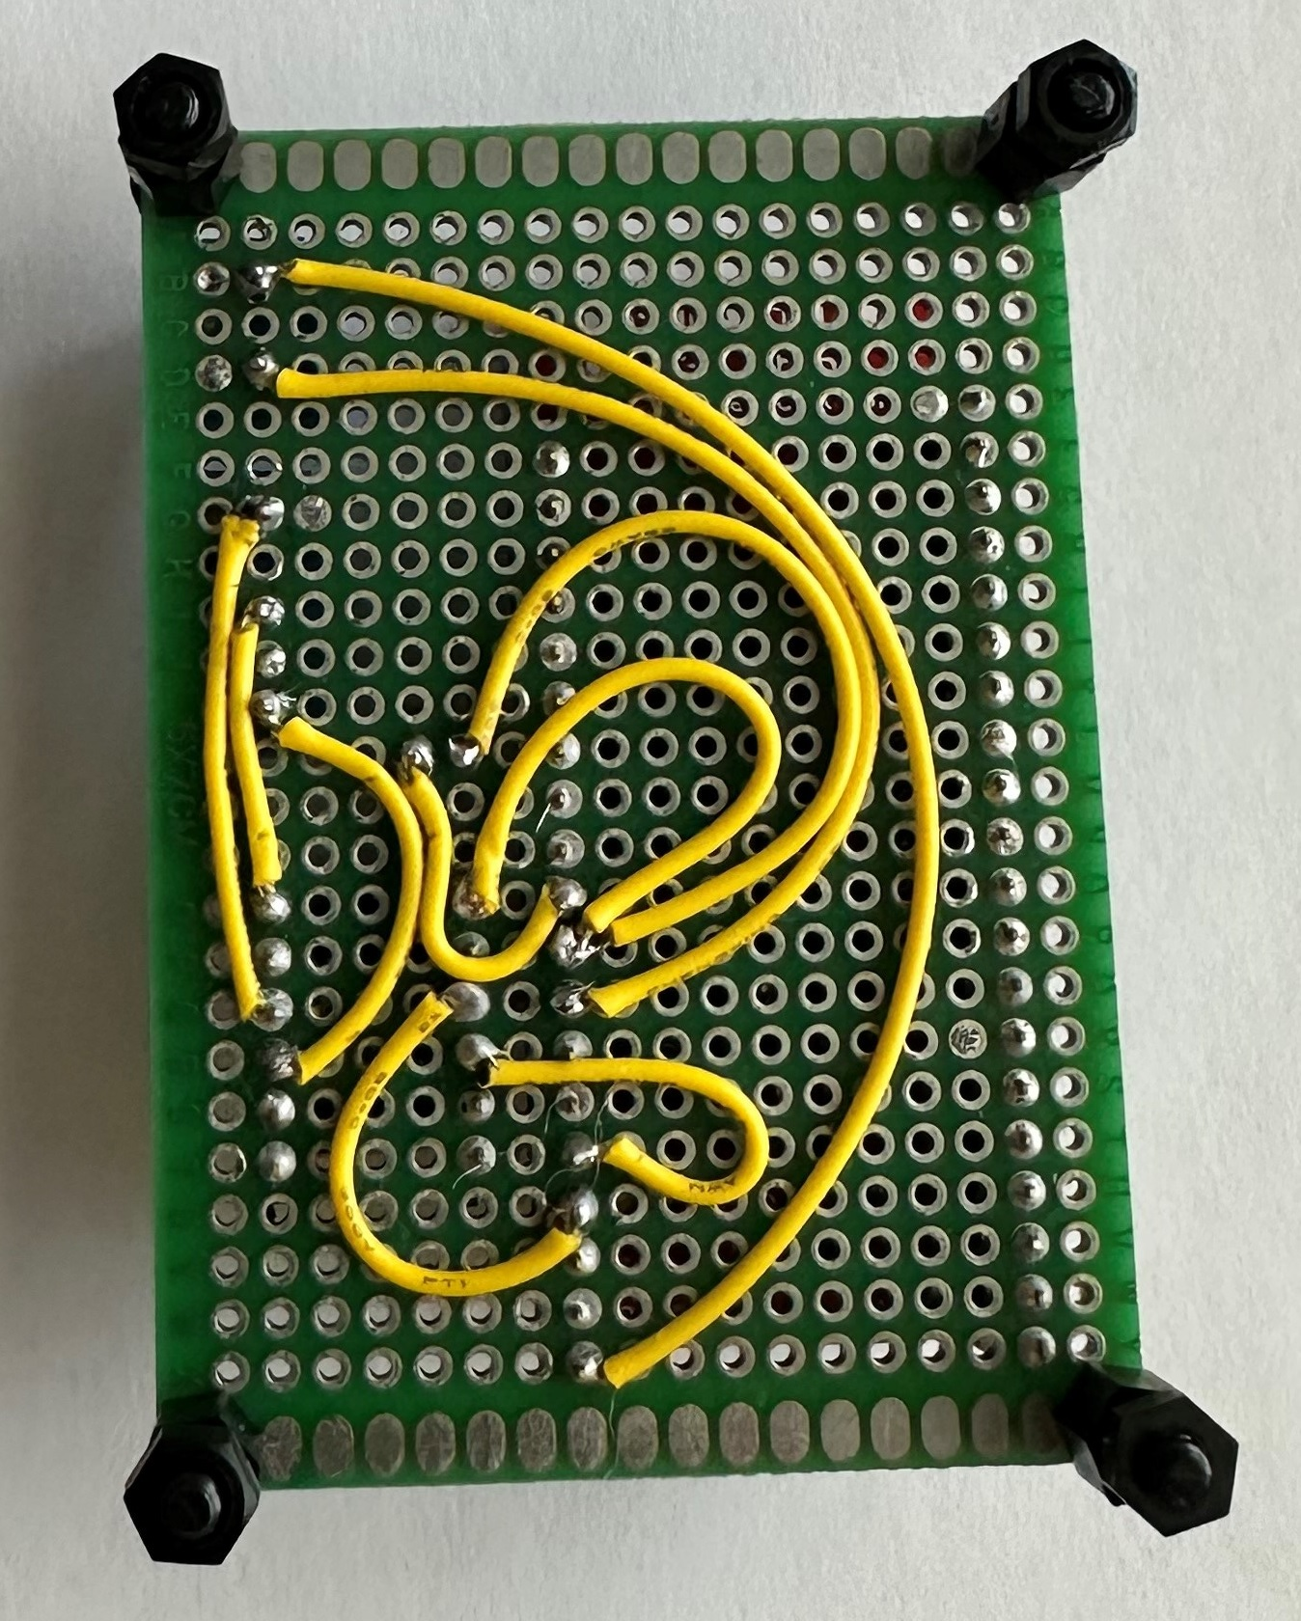
Radar Synchronization – HW
Sparkfun ESP32 Thing
Any other ESP32-based module can also work
Internal Connections
Input: Pulse inputs from AMC4030 motion controller (can also be another motion controller that works with pulses to the step motors)
Output: Radar SYNC_IN for HW trigger
GND
To Radar SYNC_IN
PULSE
GND
From AMC4030
Motion Controller
PULSE
5V
Future Work:
A PCB can be built if needed
Sparkfun Logic-Level Converter
This module is needed to convert 5V pulses from motion controller to 3.3V level into the ESP32 module
4

Slide 5
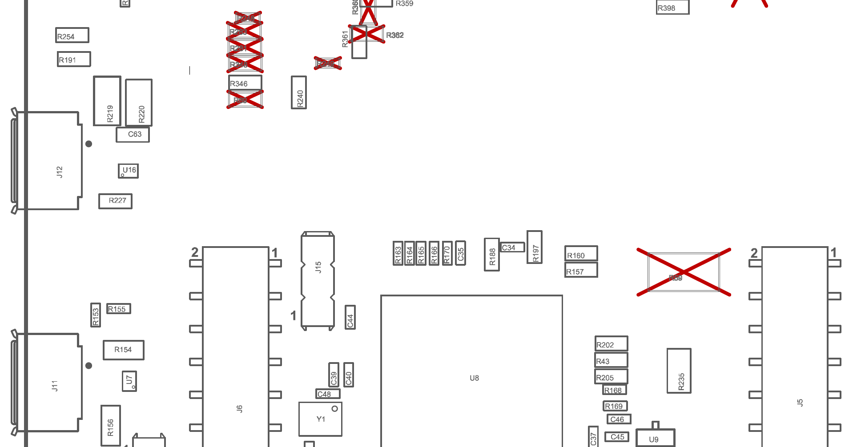
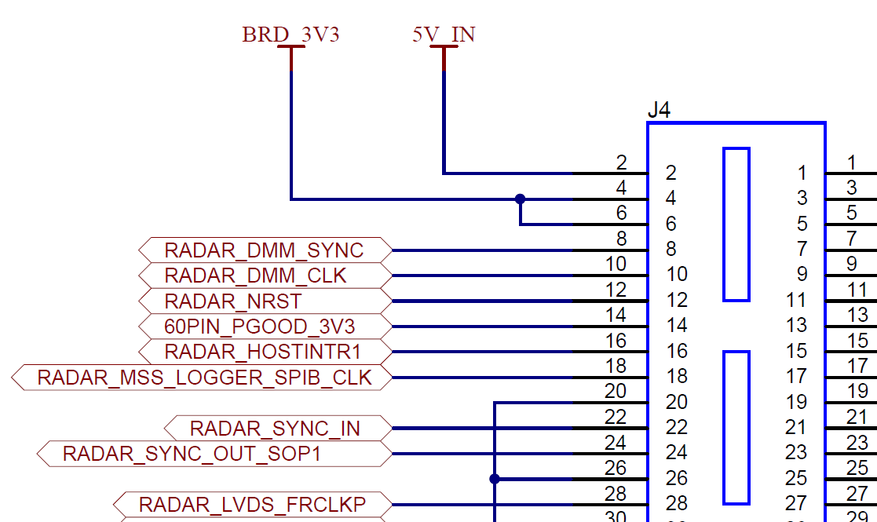
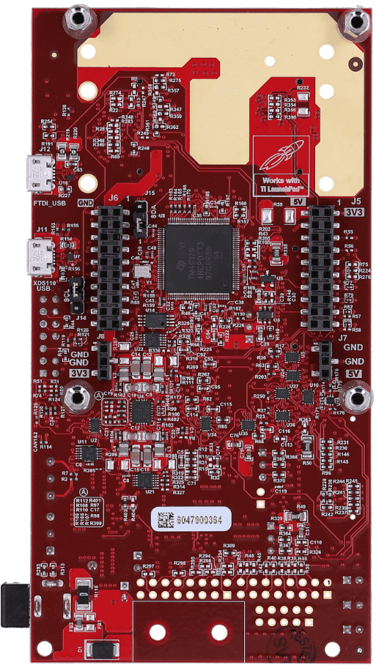
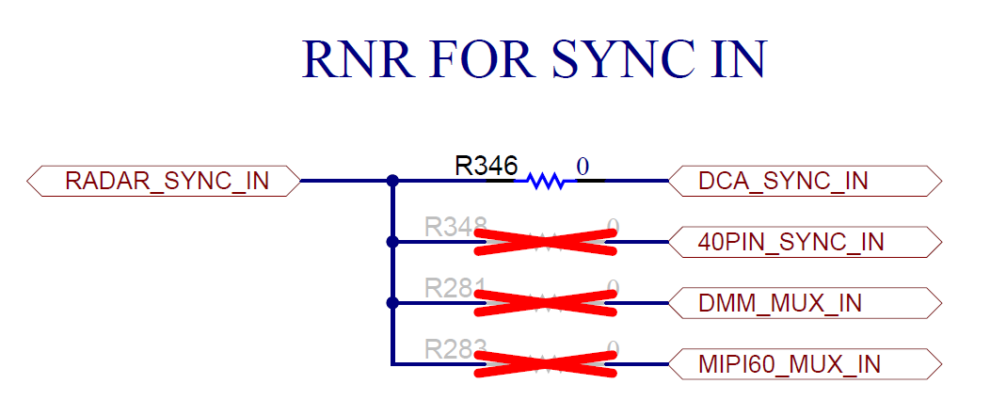
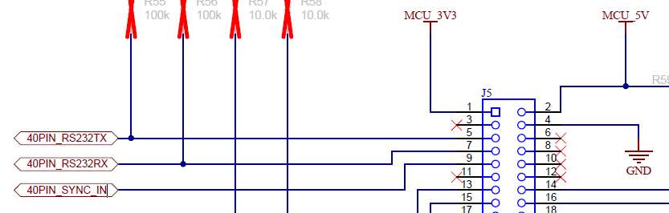
Radar HW Modifications Needed
On MMWAVEICBOOST (Rev B), RADAR_SYNC_IN is coming from Radar via J4 60-pin HD Connector
R348
R346
R346 can be removed (no needed) and can be soldered to R348
To access pin via J5 Launchpad Connector, R348 resistor should be connected (optionally, R346 can be removed)
But by default, RADAR_SYNC_IN is routed to DCA_SYNC_IN via 60-pin HD Connector for DCA1000, which is not accessible.
5

Slide 6
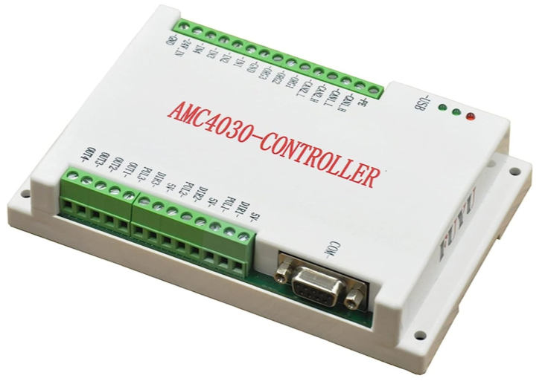
Radar Synchronization – External Connections
Radar Connections
Radar SYNC_IN to PULSE output of Synchronizer, Radar GND to GND of Synchronizer
GND
PULSE
GND
PULSE
5V
AMC4030 Controller Connections
AMC4030 5V to 5V input of Synchronizer
AMC4030 PUL1 to PULSE input of Synchronizer
AMC4030 GND to GND of Synchronizer
6

Slide 7
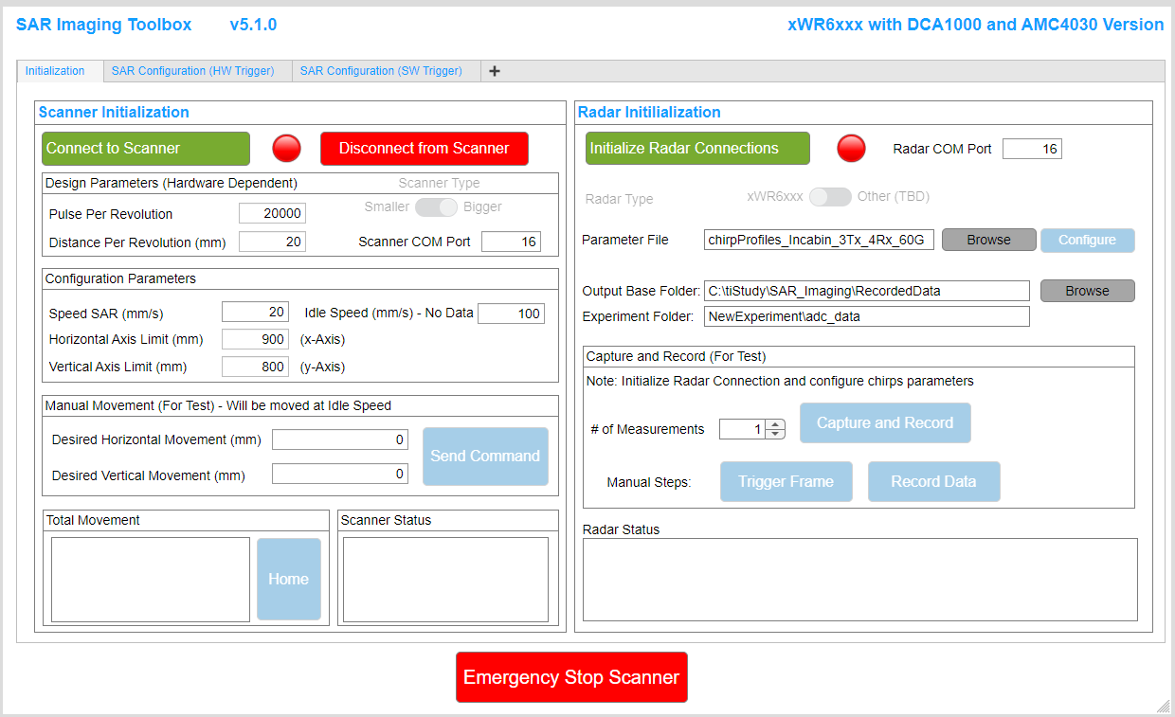
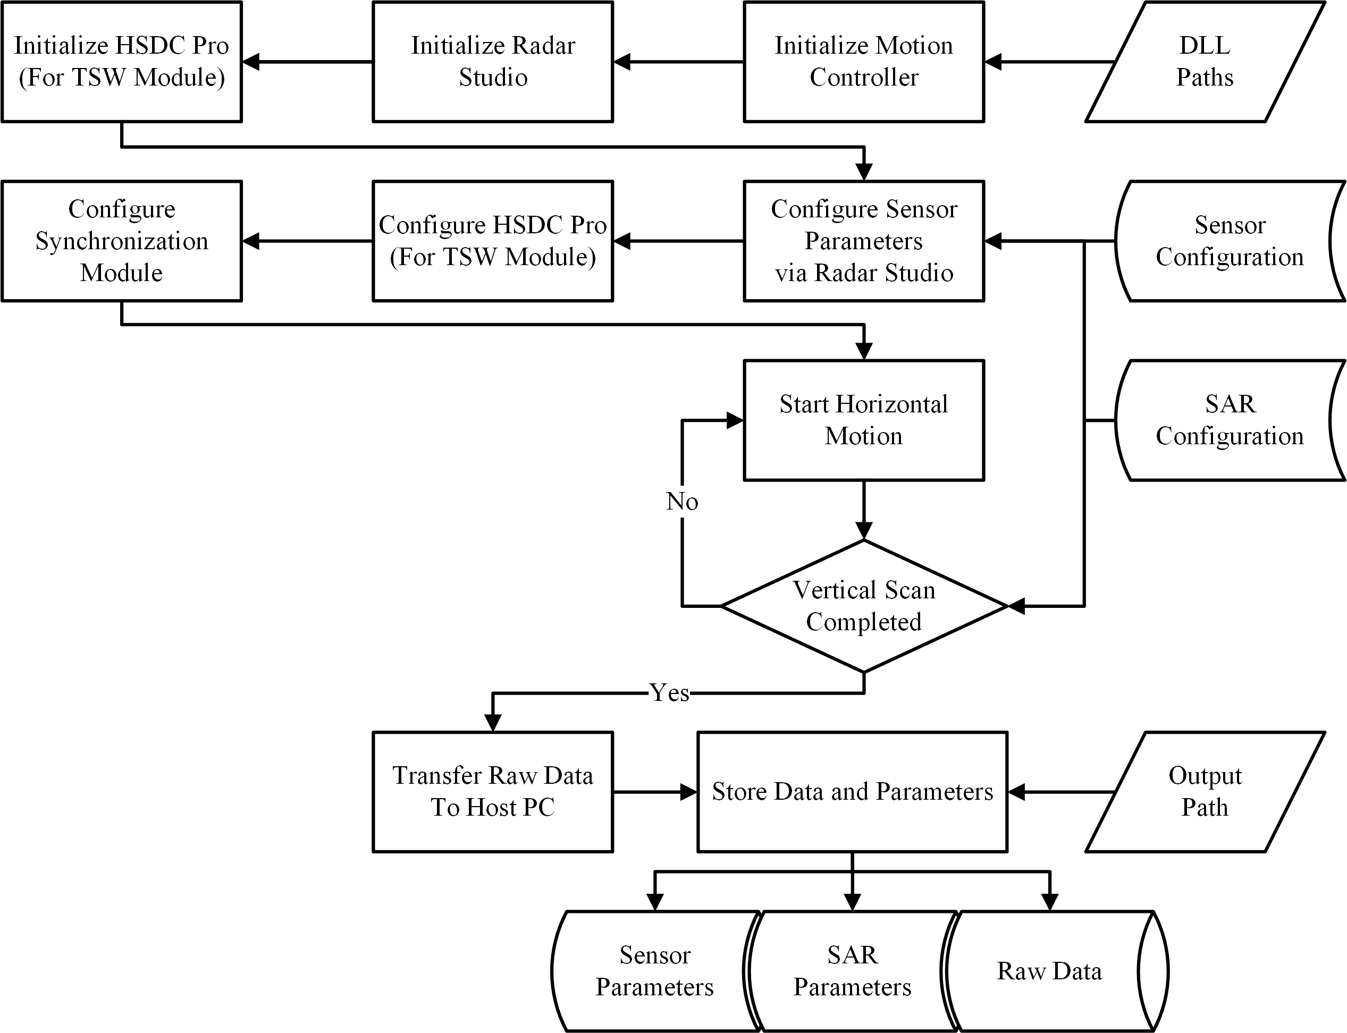
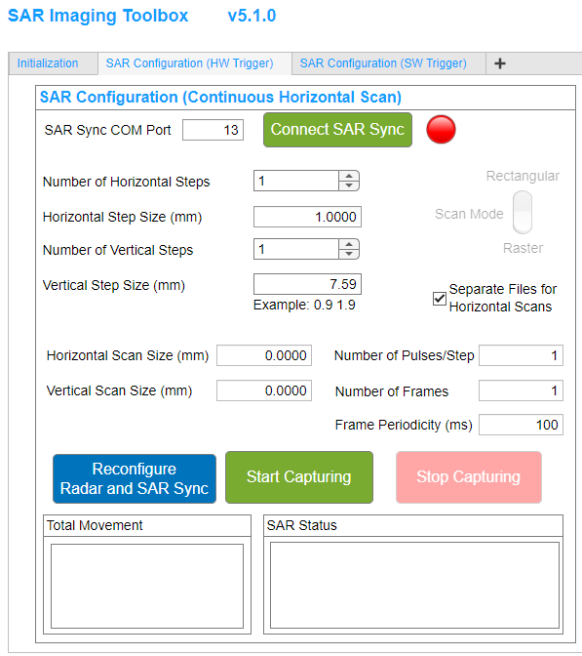
Synchronizer Integrated to the MATLAB GUI
The Synchronizer is integrated into the MATLAB GUI
Software architecture
Synchronizer Control
SAR Scenario Generation
Radar Control
Scanner Control
Fail-Safe Checks
Automated Data capture flow
API’s
MATLAB
1
In the SAR Configuration (HW Trigger Tab)
Connect to Sync COM Port
Design the SAR scenario
Reconfigure the Radar and SAR Sync
Start Capturing
Then everything will be taken care of automatically.
2
Refer to the paper for other modules (calibration, imaging algorithms, etc.)
M.E. Yanik, D. Wang, and M. Torlak, “Development and Demonstration of MIMO-SAR Millimeter-Wave Imaging Testbeds,” IEEE Access.
3
4
7

